Slide 1

IDSA Master 2022
That‘s the newest version

Slide 2
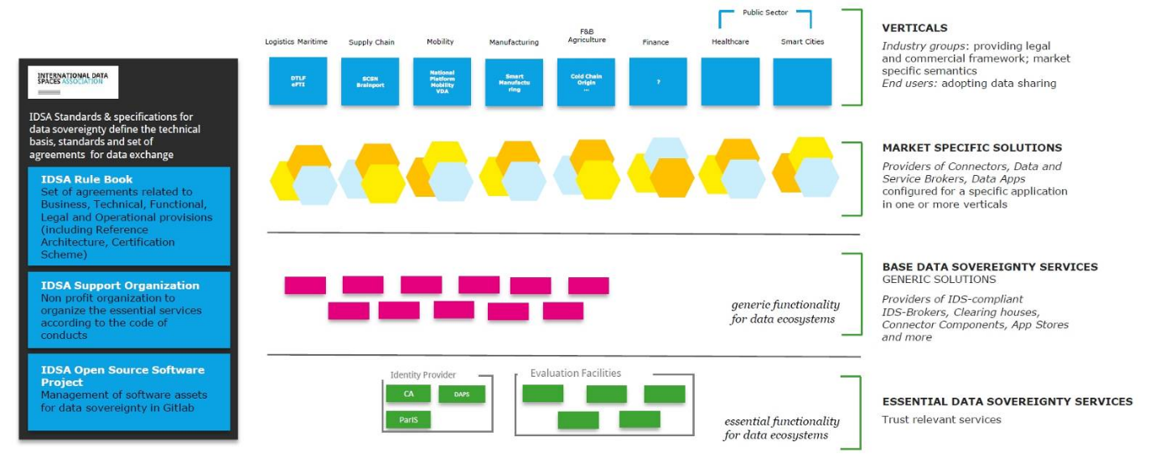
OLD VERSION
Figure 1 Overview IDS enabled ecosystems
Trust relevant services
Logistics Maritime
Essential functionality for data ecosystems

Slide 3
NEW VERSION
Figure 1 Overview IDS enabled ecosystems
Public Sector
Logistics Maritime
Supply Chain
Mobility
Manufacturing
Agriculture
Finance
Health
Smart City
Verticals
National
Platform
Mobility
VDA
Smart
Manu-facturing
Cold Chain
Origin
Industry groups: providing legal and commercial framework; market specific semantics
End users: adoption data sharing
DTLF
ePTI
SCSN
Brainport
Market specific solutions
Providers of connectors, data and service brokers, data apps
configured for a specific application in one of more verticals
Base data sovereignty services
Providers of IDS-compliant IDS-brokers, clearing houses, connector components, app stores and more
Generic functionality
for data ecosystems
Identity Provider
Evaluation Facilities
Essential data sovereignty services
CA
DAPS
Trust relevant services
ParIS
Essential functionality
for data ecosystems

Slide 4
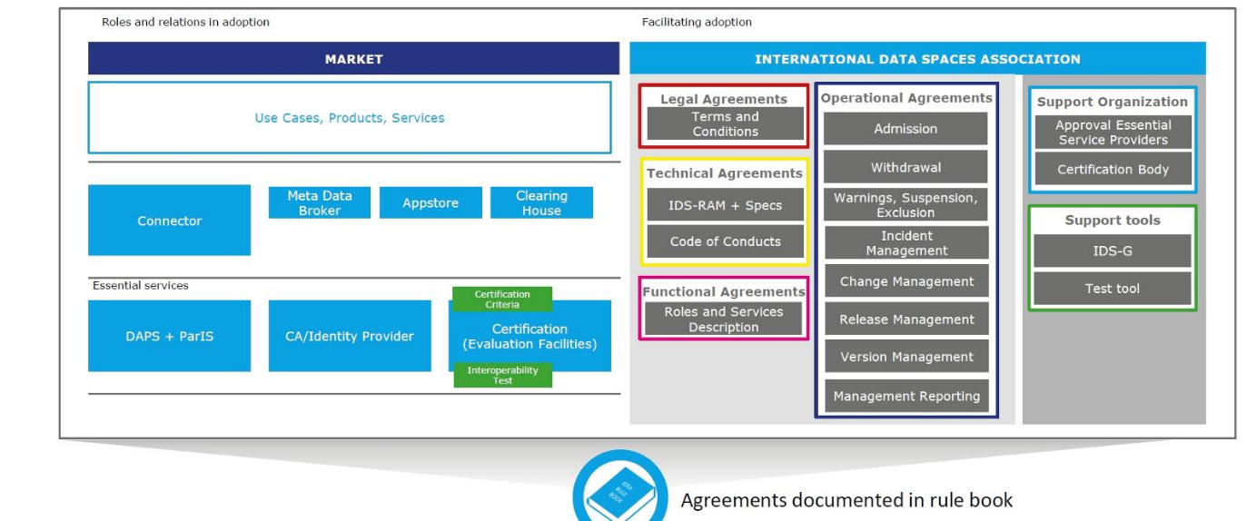
OLD VERSION
Figure 2 Overview Rule Book scope and goals

Slide 5

NEW VERSION
Figure 2 Overview Rule Book scope and goals
Market
International Data Spaces Association
Use cases, products, services
Legal agreements
Operational agreements
Support Organization
Terms and conditions
Admission
Approval essential service providers
Technical agreements
Withdrawal
Certification body
Meta Data
Broker
Appstore
Clearing House
Warnings, suspension, exclusion
Connector
IDS-RAM + specs
Support tools
Code of conduct
Incident management
IDS-G
Essential services
Certification
Criteria
Functional agreements
Change management
Test tool
CA/Identity Provider
Certification
(Evaluation Facilities)
Roles and services description
Release management
DAPS + ParIS
Interoperability Test
Version management
Management reporting
Agreements documented in the Rulebook

Slide 6
NEW VERSION
Figure 2 Overview Rule Book scope and goals
Market
International Data Spaces Association
Use cases, products, services
Legal agreements
Operational agreements
Support Organization
Terms and conditions
Admission
Approval essential service providers
Technical agreements
Withdrawal
Certification body
Meta Data
Broker
Appstore
Clearing House
Warnings, suspension, exclusion
Connector
IDS-RAM + specs
Support tools
Code of conduct
Incident management
IDS-G
Essential services
Certification
Criteria
Functional agreements
Change management
Test tool
CA/Identity Provider
Certification
(Evaluation Facilities)
Roles and services description
Release management
DAPS + ParIS
Interoperability Test
Version management
Management reporting
Agreements documented in the Rulebook

Slide 7
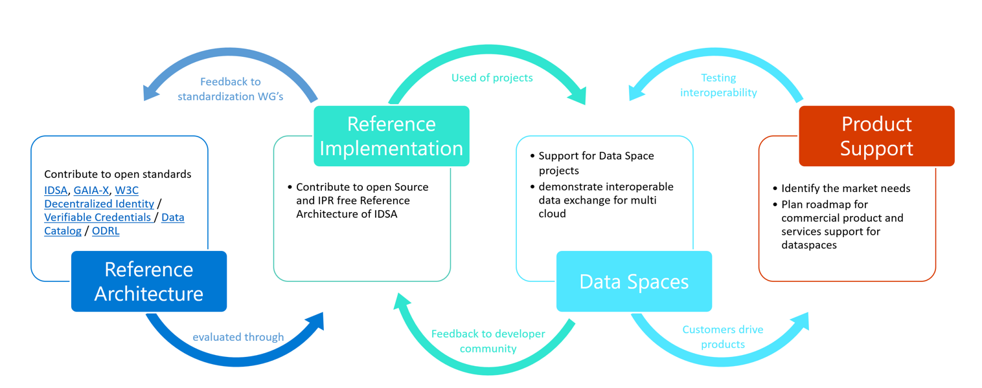
OLD VERSION

Slide 8
NEW VERSION
Figure 3 Collaborative Development of Architectures and Implementations in Data Spaces
Feedback to
standardization WG‘s
Used by projects
Testing
interoperability
Contribute to open standards
IDSA, Gaia-X, W3C Decentralized Identity / Verifiable Credentials / Data Catalog / ODRL
Reference
Implementation
Support for data space projects
Demonstrate interoperable data exchange for multi cloud
Product Support
Contribute to open-source and IPR free Reference Architecture of IDSA
Identify the market needs
Plan roadmap for commercial product and services support for data spaces
Reference
Architecture
Data
Spaces
evaluated through
Feedback to developer community
Customers drive
products

Slide 9
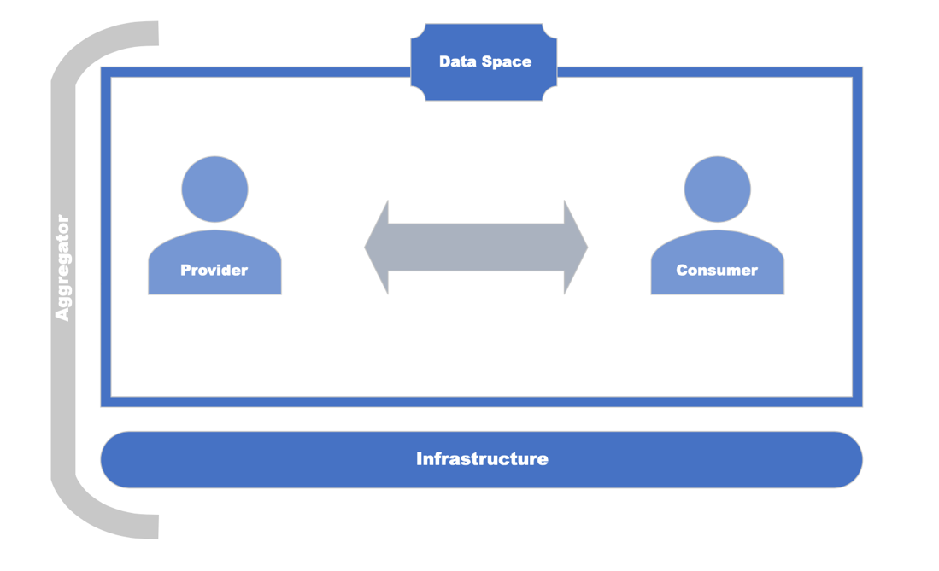
OLD VERSION
Figure 5 Roles in a data space

Slide 10
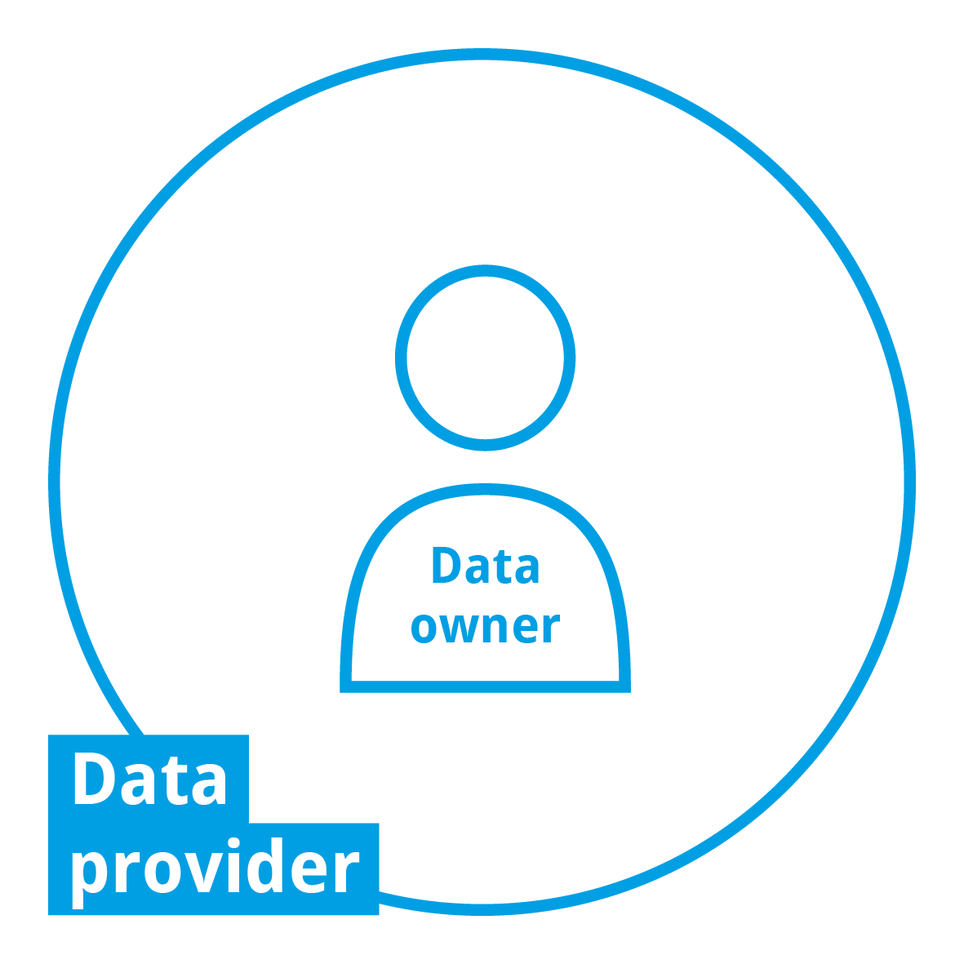
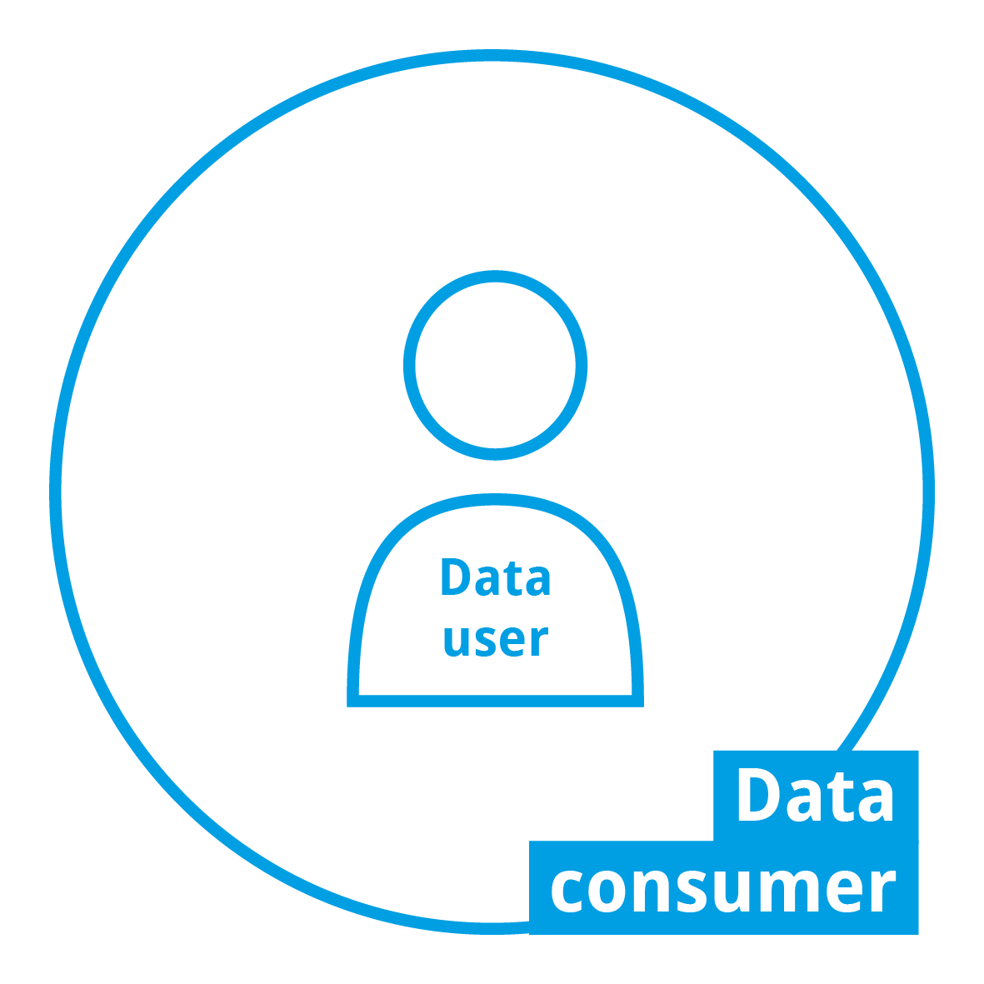
NEW VERSION
Figure 5 Roles in a data space
Data Space
Aggregator
Infrastructure

Slide 11
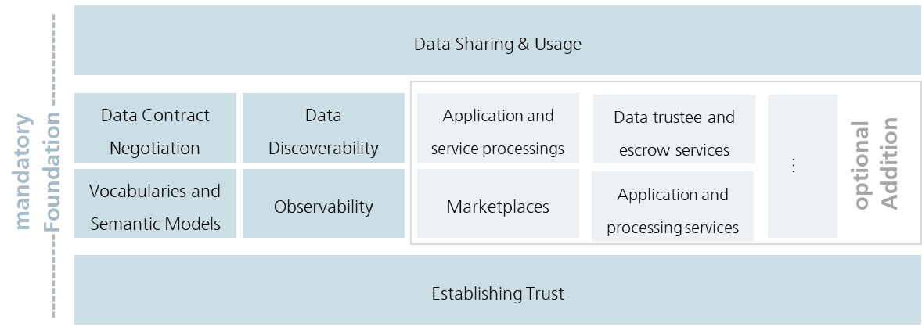
OLD VERSION
Figure 6 Foundational Concepts in data spaces

Slide 12
NEW VERSION
Figure 6 Foundational Concepts in data spaces
Data sharing & usage
Data contract
negotiation
Data discoverability
Application and service processings
Data trustee and escrow services
Mandatory
foundation
…
Optional
addition
Vocabularies and semantic models
Observability
Marketplaces
Application and processing services
Establishing trust

Slide 13
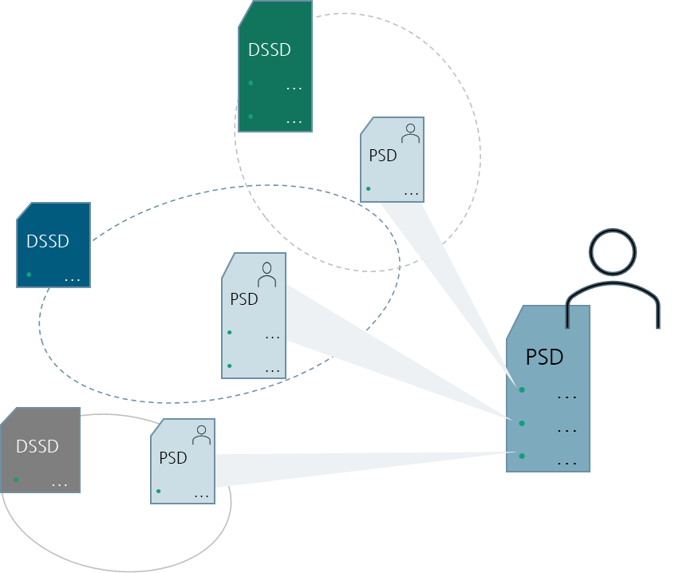
OLD VERSION
Figure 7 Self Descriptions in data spaces

Slide 14




NEW VERSION
DSSD
…
Figure 7 Self Descriptions in data spaces
PSD
…
DSSD
…
PSD
…
PSD
DSSD
…
…
…
…
PSD
…

Slide 15
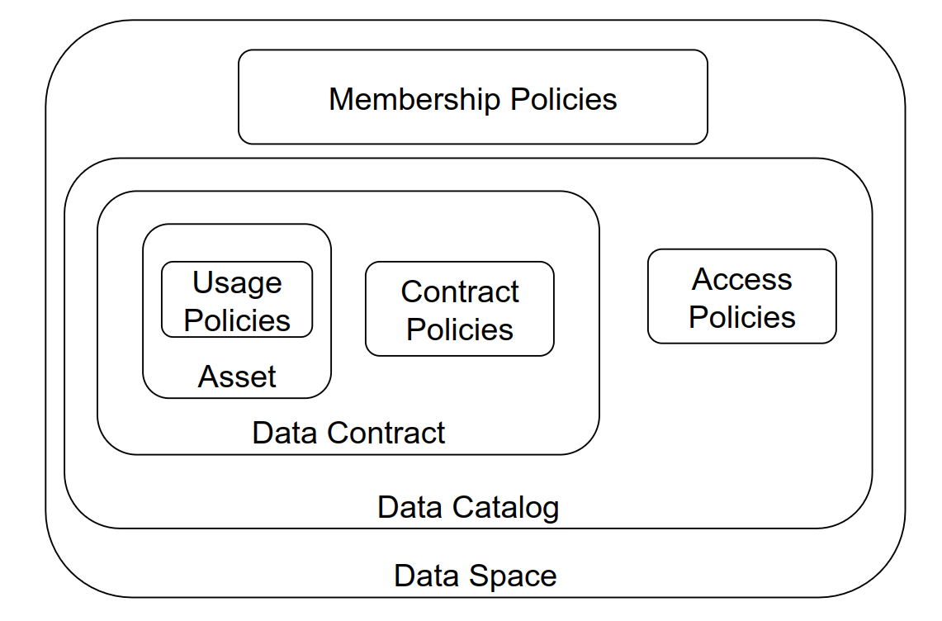
OLD VERSION
Figure 8 Different policies in data spaces

Slide 16
NEW VERSION
Figure 8 Different policies in data spaces
Membership policies
Usage
policies
Contract
policies
Access
policies
Asset
Data contract
Data catalogue
Data space

Slide 17
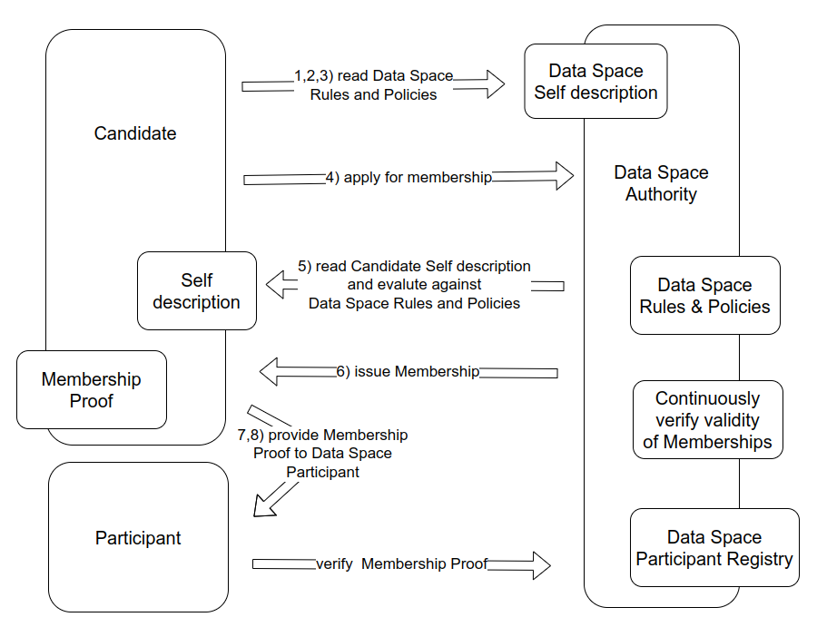
OLD VERSION
Figure 9 Onboarding in data spaces
7), 8) Provide membership proof to data space participant

Slide 18
NEW VERSION (DEPRECATED)
Figure 9 Onboarding in data spaces
1), 2), 3), Read data space
rules & policies
Data space
self description
Candidate
4) Apply for membership
Data space
authority
5) Read candidate self description and evaluate against data space rules and policies
Self
description
Data space
rules & policies
Membership proof
6) Issue membership
Continuously
verify validity
of memberships
7), 8) Provide membership proof to data space participant
Data space
Participant
registry
Participant
9) Verify membership proof

Slide 19
NEW VERSION
Figure 9 Onboarding in data spaces
1), 2), 3), Read data space
rules & policies
Data space
self description
Candidate
4) Apply for membership
Data Space
GovernanceAuthority
5) Read candidate self description and evaluate against data space rules and policies
Self
description
Data space
rules & policies
Membership proof
6) Issue membership
Continuously
verify validity
of memberships
7), 8) Provide membership proof to data space participant
Data space
Participant
registry
Participant
9) Verify membership proof

Slide 20
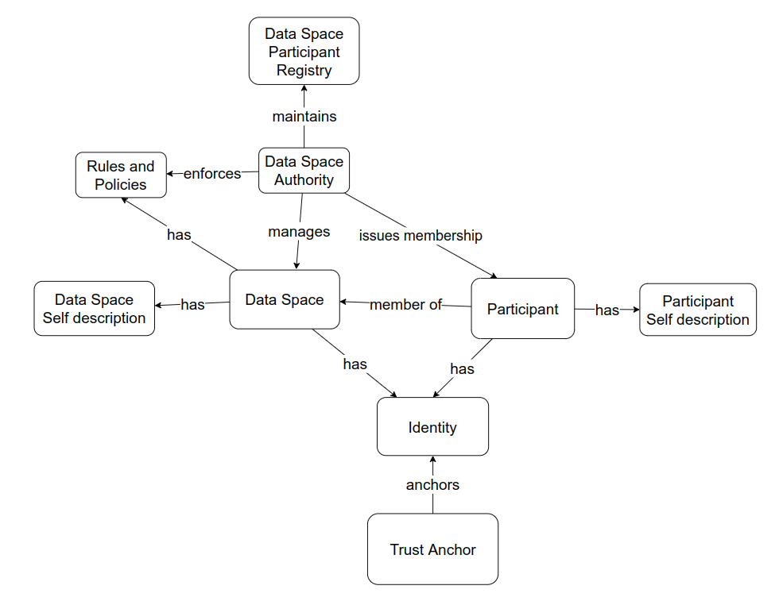
OLD VERSION
Figure 10 Relationships and concepts

Slide 21
NEW VERSION
Data space
participant registry
maintains
Rules
and policies
Data Space
Governance Authority
enforces
issues membership
has
manages
Data space
self description
Data space
has
Participant
self description
has
member of
Participant
has
has
Identity
anchors
Trust
anchor

Slide 22
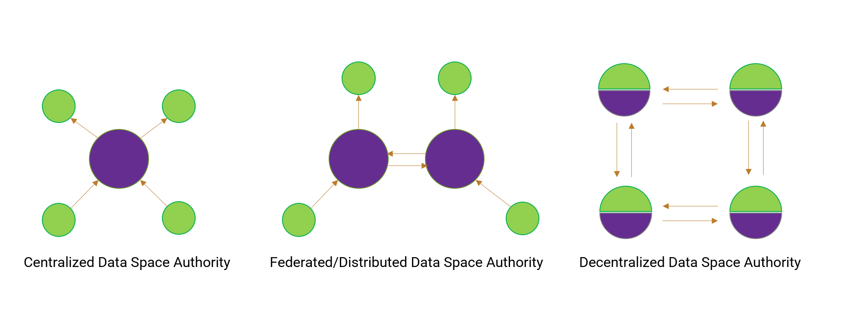
OLD VERSION
Figure 11 Variants for data space authorities

Slide 23

NEW VERSION
Figure 11 Variants for data space authorities
Centralized
data space governance authority
Federated/distributed data space governance authority
Decentralized
data space governance authority

Slide 24
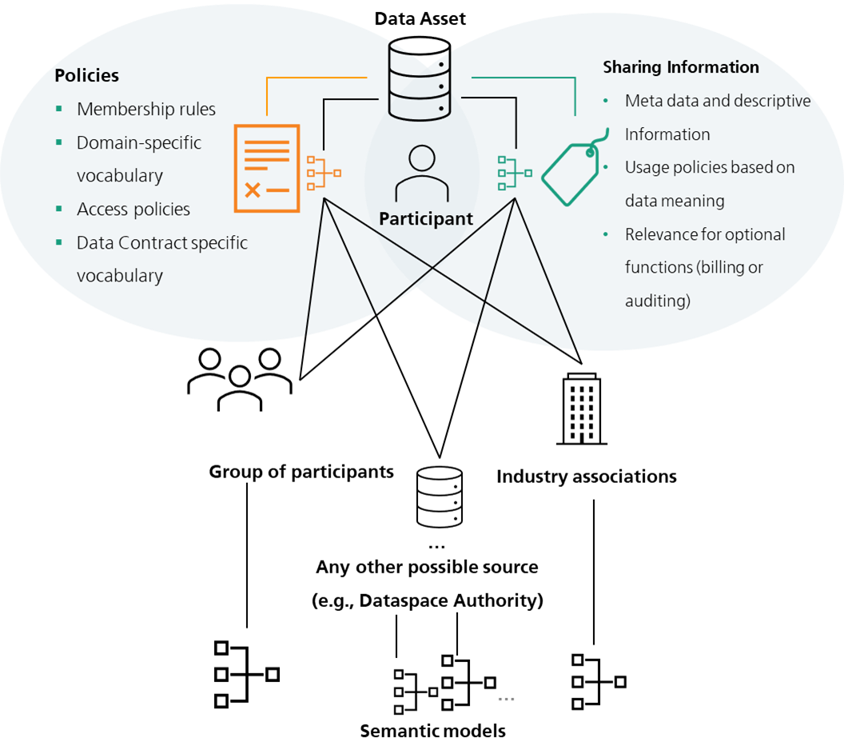
OLD VERSION
Figure 12 Vocabularies and their relationship to data assets
Membership rules
Domain-specific vocabulary
Access policies
Data contract specific vocabulary

Slide 25








NEW VERSION
Figure 12 Vocabularies and their relationship to data assets
Data asset
Policies
Sharing information
Membership rules
Domain-specific vocabulary
Access policies
Data contract specific vocabulary
Metadata and descriptive information
Usage policies based on data meaning
Relevance for optional functions (billing or auditing)
Participant
Group of participants
Industry association
…
Any other possible source (e.g. Data Space Authority)
Semantic models

Slide 26
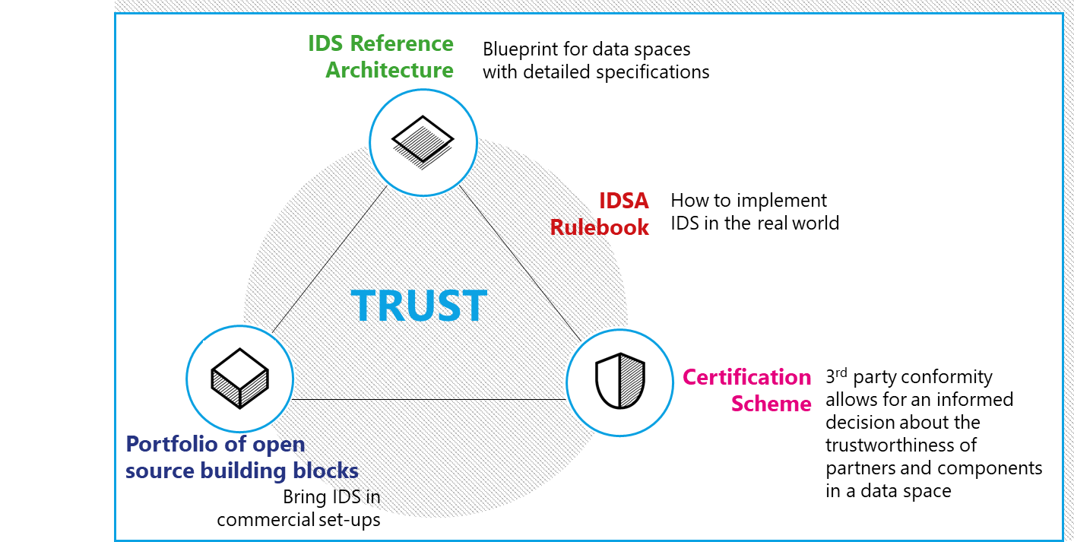
OLD VERSION
Figure 19 IDSA Magic Triangle

Slide 27



NEW VERSION
Figure 19 IDSA Magic Triangle
IDS Reference
Architecture
Blueprint for data spaces with
detailed specifications
+
IDSA Rulebook
How to implement IDS in the real world
Trust
Portfolio of open-source building blocks
Certification Scheme
Bring IDS in
commercial set-ups
3rd party conformity allows for an informed decision about the trustworthiness of partners and components in a data space

Slide 28
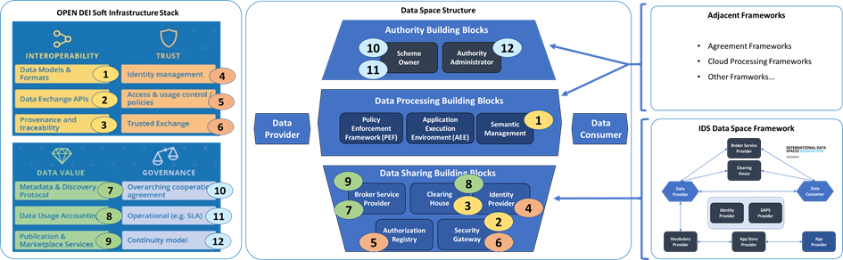
OLD VERSION
Figure 20 Relationship of OpenDEI Building Blocks and data space instances

Slide 29



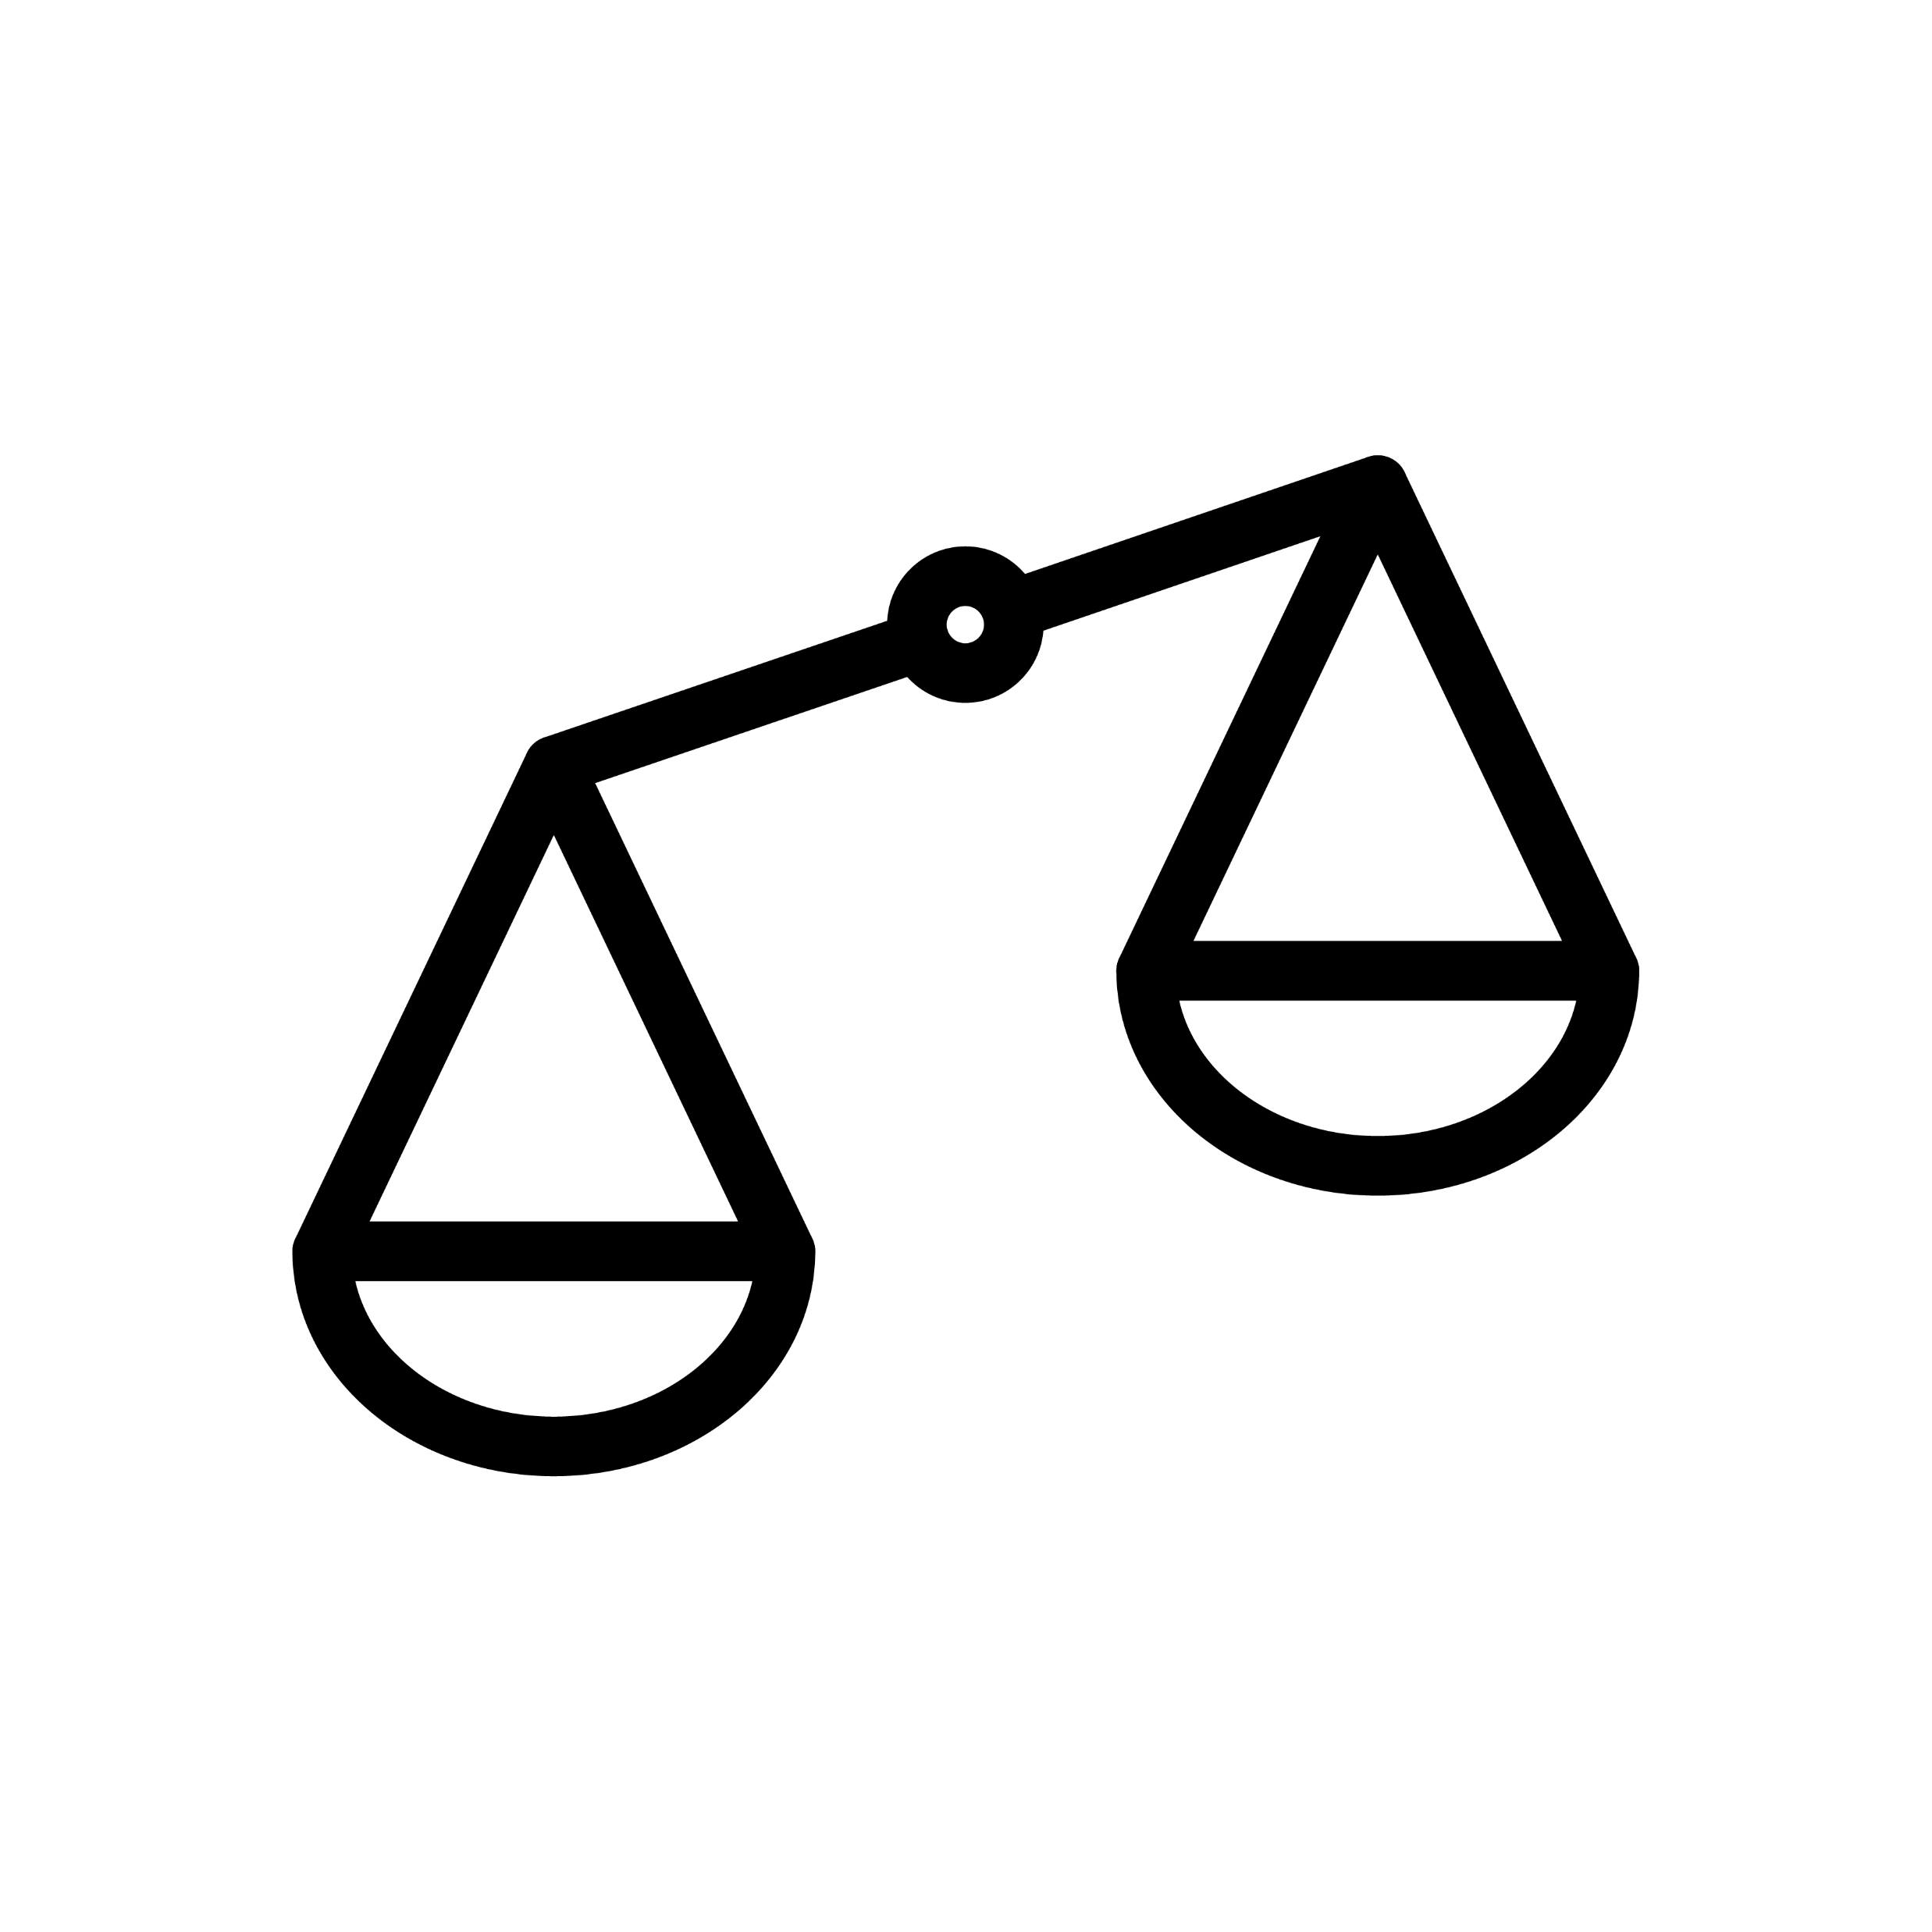
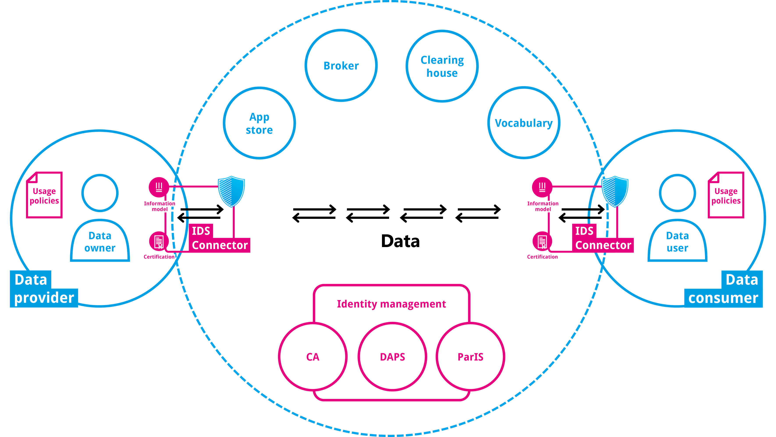
NEW VERSION
Figure 20 Relationship of OpenDEI Building Blocks and data space instances
OPEN DEI Soft Infrastructure Stack
Data Space Structure
Adjacent Frameworks
Authority Building Blocks
10
Scheme
owner
Authority
administrator
12
Agreement Frameworks
Cloud Processing Frameworks
Other Frameworks …
Interoperability
Trust
11
Data models
& formats
1
Identity management
4
Data exchange APIs
2
Access & usage control policies
5
Data Processing Building Blocks
Provenance and tracability
3
Trusted exchange
6
Policy Enforcement Framework (PEF)
Application Execution Environment (AEE)
Semantic
Management
1
IDS Data Space Framework
Data value
Trust
Metadata & discovery protocol
7
Overarching cooperation agreeent
10
Data Sharing Building Blocks
9
Broker
Service
Provider
8
Data usage accounting
8
Operational
(e.g. SLA)
11
7
Clearing
House
3
Identity
Provider
4
Publication & marketplace services
9
Continuity model
12
5
2
Authorization
Registry
Security
Gateway
6

Slide 30
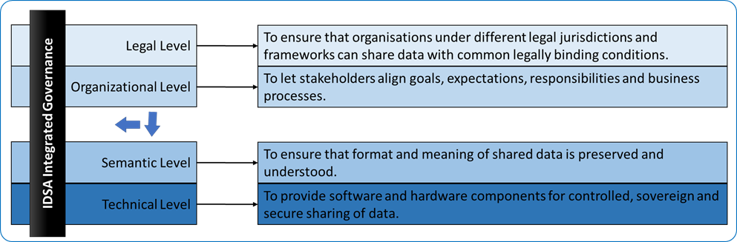
OLD VERSION
IDSA Integrated Governance
Figure 21 Layered functional model as aligned with the New European Interoperability Framework [8].

Slide 31
NEW VERSION
Figure 21 Layered functional model as aligned with the New European Interoperability Framework [8].
Legal level
To ensure that organizations under different legal jurisdictions and frameworks can share data with common legally binding conditions.
Organizational level
To let stakeholders align goals, expectations, responsibilities
and business processes.
IDSA Integrated Governance
Semantic level
To ensure that format and meaning of shared data is preserved
and understood.
Technical level
To provide software and hardware components for controlled, sovereign and secure sharing of data.

